Slide 1
Economics 6 Supply and Demand CFA #2
Review.
Please answer each question on loose-leaf paper- Number each question, but do not copy down the question… Just write the answer-
Turn in your responses when you finish

Slide 2
Question 1
What is literacy rate?
How might it affect a country’s GDP? (Gross Domestic Product)

Slide 3
Question 2
What is a surplus?
How does a surplus of a product affect the price?

Slide 4
Question 3
Is the following graph an example of a supply curve or a demand curve?

Slide 5
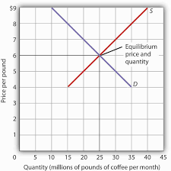
Question 4
What is the equilibrium, or market price of coffee according to this graph?

Slide 6
Question 5
Use the following terms IN ONE sentence (not a definition) to show your understanding of the terms…
Market, Supply, and Increase

Slide 7
Question 6
Use the following terms IN ONE sentence (not a definition) to show your understanding of the terms…
Consumer, Supply, and Price

Slide 8
Question 7
Why would a country with a 42% population under the age of 15 struggle to maintain a high GDP?

Slide 9
Question 8
In deciding on an appropriate price for a product, producers generally use trial and error- Explain this process…

